Slide 1
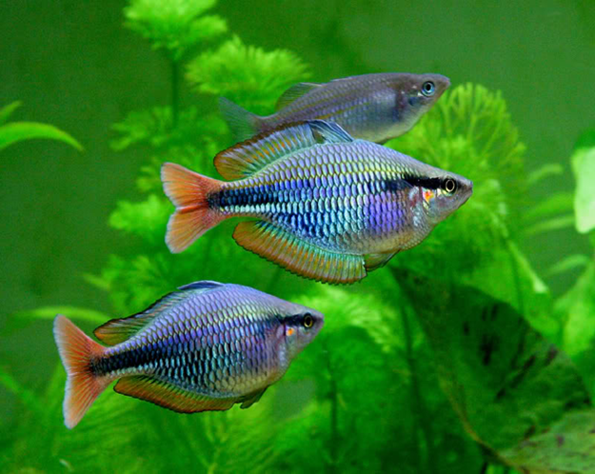
By Omeet faisel
Department of Pathology and Poultry diseases
College of Veterinary Medicin
University of Basrah
Fish diseases - year 5
Chapter 1:Parasitic diseases:
University of Basrah-College of Veterinary Medicin-Department of Pathology and Poultry disease

Slide 2
Parasitic diseases:
Infected fish show a number of changes, including lethargy in the fish, change in body color, the presence of some worms on the body, erosion of the tail and fins, loss of scales in some areas of the skin, the presence of ulcers, the presence of spots resembling cotton lint clusters on the skin, gills or mouth, protrusion or Eye color change, abdominal bloating, spinal curvature, etc

Slide 3
The spread of diseases in farmed fish has many causes, including:
Exposure of the fish to stress, incorrect transportation of fish, introduction of new imported fish, stocking density, presence of local fish carrying the disease and weak immunity.

Slide 4
Parasites can be divided according to their external shap and anatomical structure into:
1*-( Protozoa):
1- Flagellates
2-Cilliophora
3- Sporozoa
2*-(Metazoa)
A- Monogenea
Digenea B-

Slide 5
C- Cestoda
D- Nematoda
E- Acanthocephala
F- Leeches
3*- Crustaceans
A- Copepoda
B- Branchiura
C- Isopoda

Slide 6
Monohost :
They are external parasites that parasitize on the skin and gills. They possess a fastening organ at the back of the body, which includes a number of large hooks and small hooklets. They do not need an intermediate host to complete their life cycle (direct life cycle). Monogynies is a parasite that causes problems and losses to fish in natural waters and breeding ponds alike. Among the most

Slide 7
important genera recorded in Iraq are:
1- Dactylogyrus
They are worms with elongated bodies, their front end has four extensions with four black eye spots, and the back disc has two large and 14 small canines. They are oviparous. They .parasitize mainly on the gills and sometimes on the skin

Slide 8
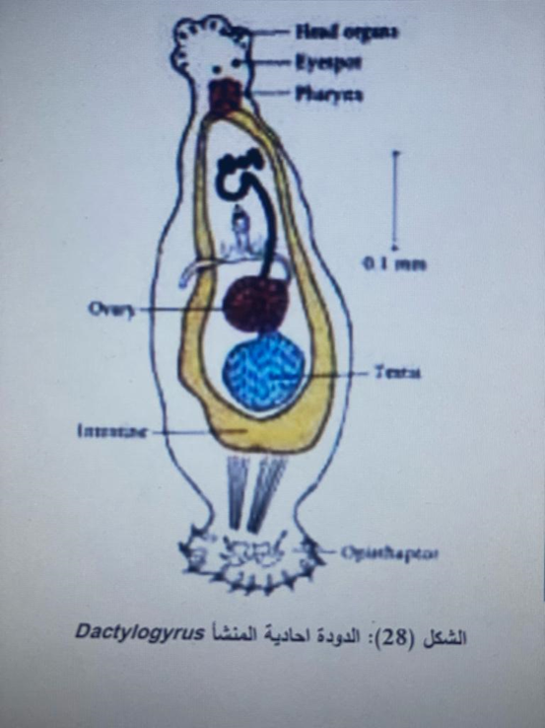
Dactylogyrus

Slide 9
2- Gyrodactylus
It is similar to the previous genus, except that its front limb has two extensions and there are no eye spots, and the posterior disc bears a pair of large hooks and 16 small hooks. They are viviparous and parasitize mainly on the skin and sometimes on the gills.

Slide 10
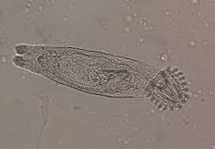
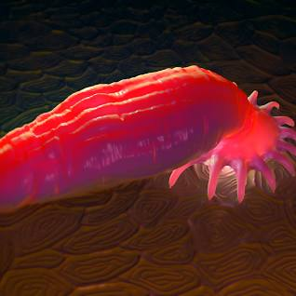
Gyrodactylus

Slide 11
3- Diplozoon
It is also called the twin worm because it consists of two worms permanently and closely attached. The front end carries the mouth located in the middle of the oral cavity, which leads to the pharynx, then the esophagus, then the intestine, which is branched and forked so strongly that it occupies most parts of the body. The back of the worm bears a number of claws that the parasite uses to attach itself to the host

Slide 12
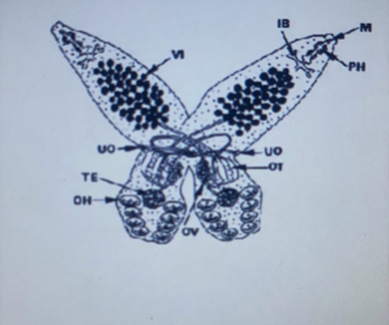
Diplozoon

